Slide 1
Fuse/Relay Box
Starter
Dirty Bus +
Engine
150A Breaker
Alternator
Firewall
Killswitch
Defroster
Switch Panel
Sensors
Gauges Data Log
30A Relay
Clean Bus+
Clean Bus -
30A Breaker
100A Breaker
Chassis Ground
Coolsuit

Slide 2
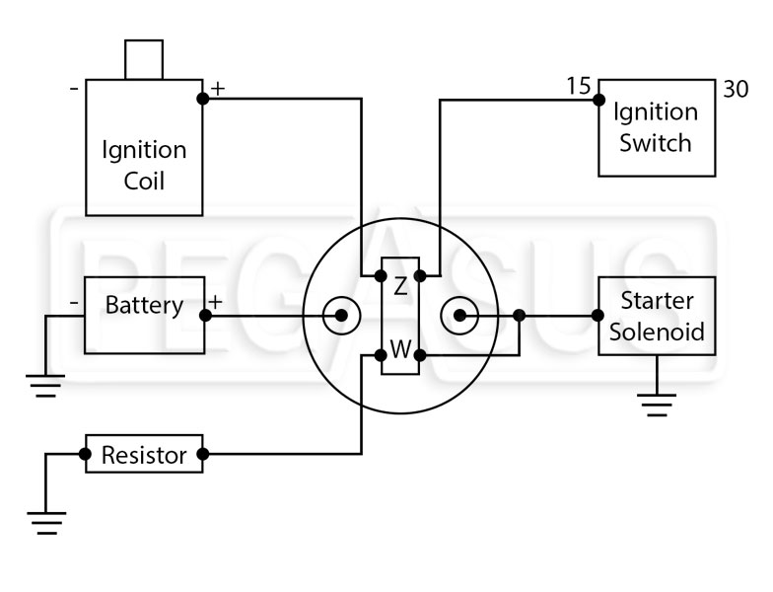
Killswitch

Slide 3
Switch Panel
Fans
Gauges
CoolSuit Pump
Extra Switch
Defroster
Rotary Wiper Switch

Slide 4
Gauges
GS Pressure Sensor
GS Temp Sensor
Wideband O2
Oil Cooler Sandwich Plate 1/8 NPT
Glowshift Oil Pressure
Glowshift Oil Temp
AEM AFR
“Electronics” Switch
30A Relay
Clean Bus+
Clean Bus+

